Slide 1
COMPARISON AND CONTRAST ESSAY

Slide 2
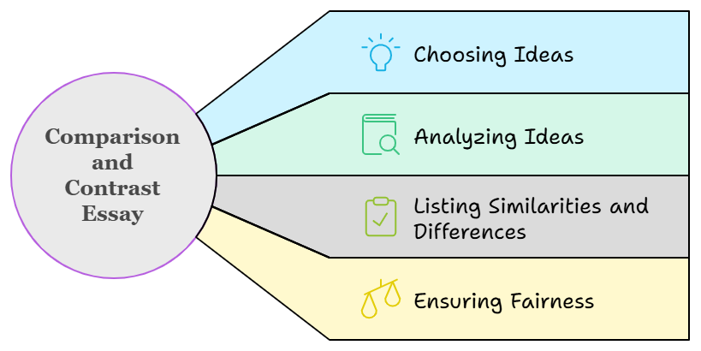
A comparison is the process of showing how things are alike; a contrast is the process of showing differences.

Slide 3
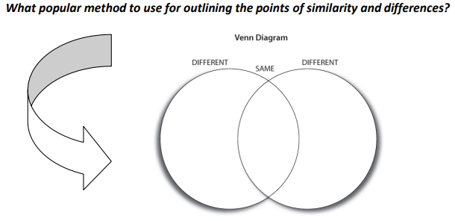

Slide 4
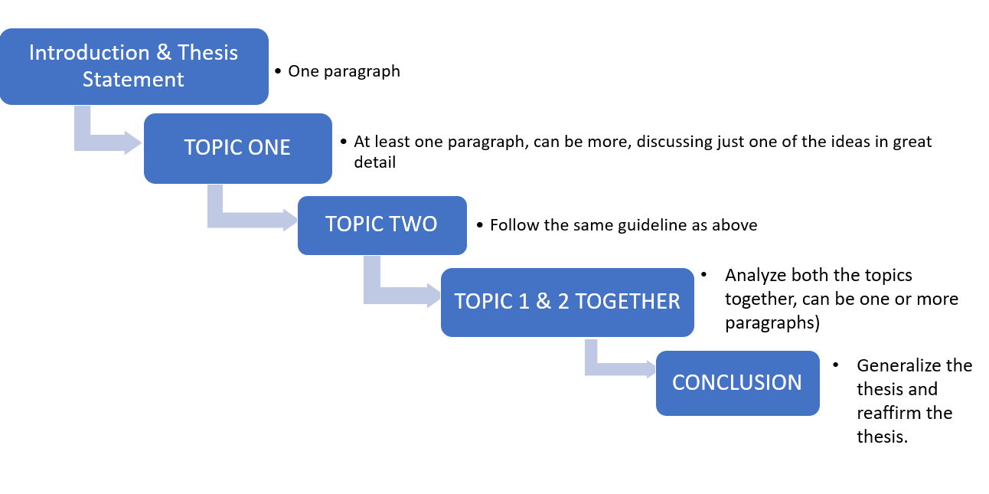
Writing the Compare and Contrast Essay
Basic Format

Slide 5
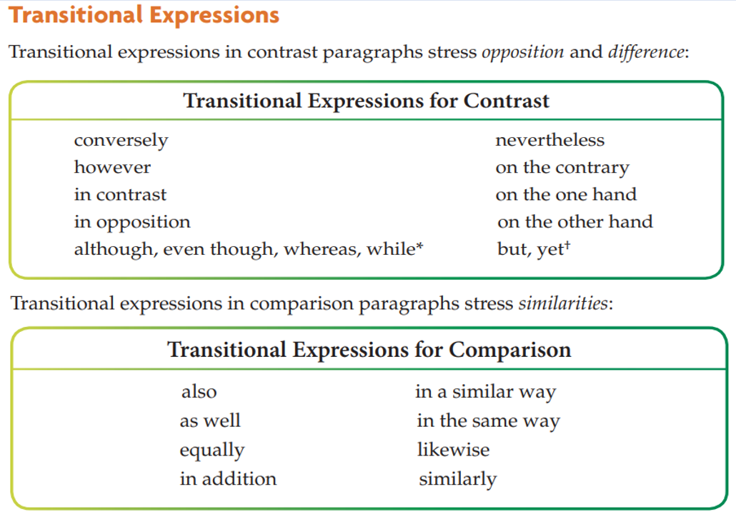

Slide 6
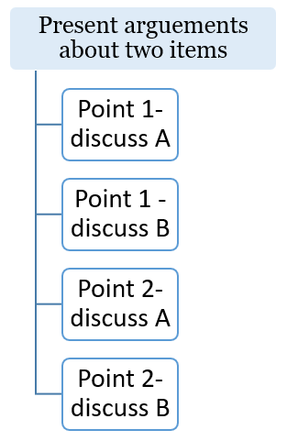
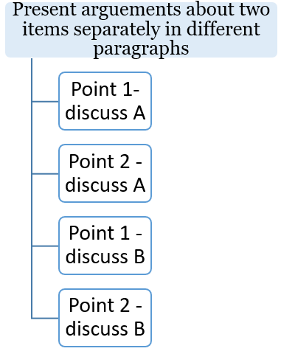
Organizational Patterns:
Point-by-Point Arrangement
Block Arrangement
Overall links between 1A & 1B
Point 1 about B (with discussion about connections to A)
Overall links between 2A & 2B
Point 2 about B (with discussion about connections to A)

Slide 7
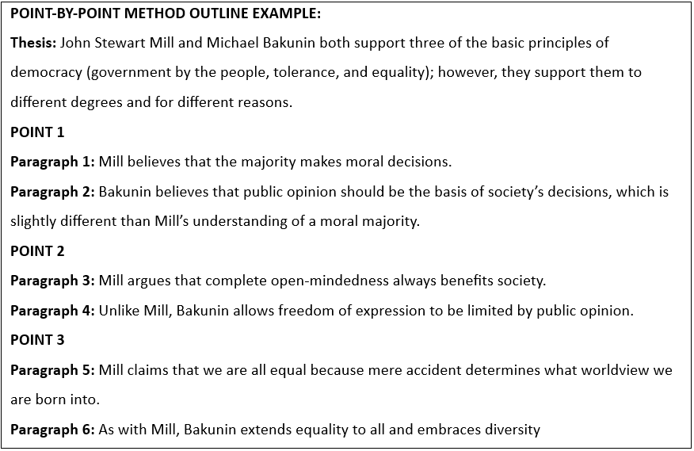

Slide 8
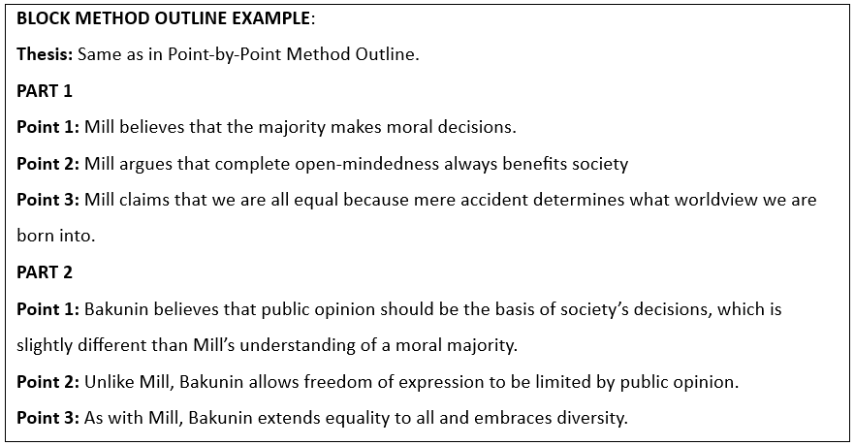

Slide 9
Check page #132- 135 for the sample essay

